Slide 1
Steps towards usable verification
Francesco Logozzo
MSR: M. Fahndrich*, M. Barnett, T. Ball, S. Lahiri
(Great) interns: P. & R. Cousot, M. Bouaziz, J.-H. Jourdan, V. Laviron, S.Blackshear , S. Carr

Slide 2
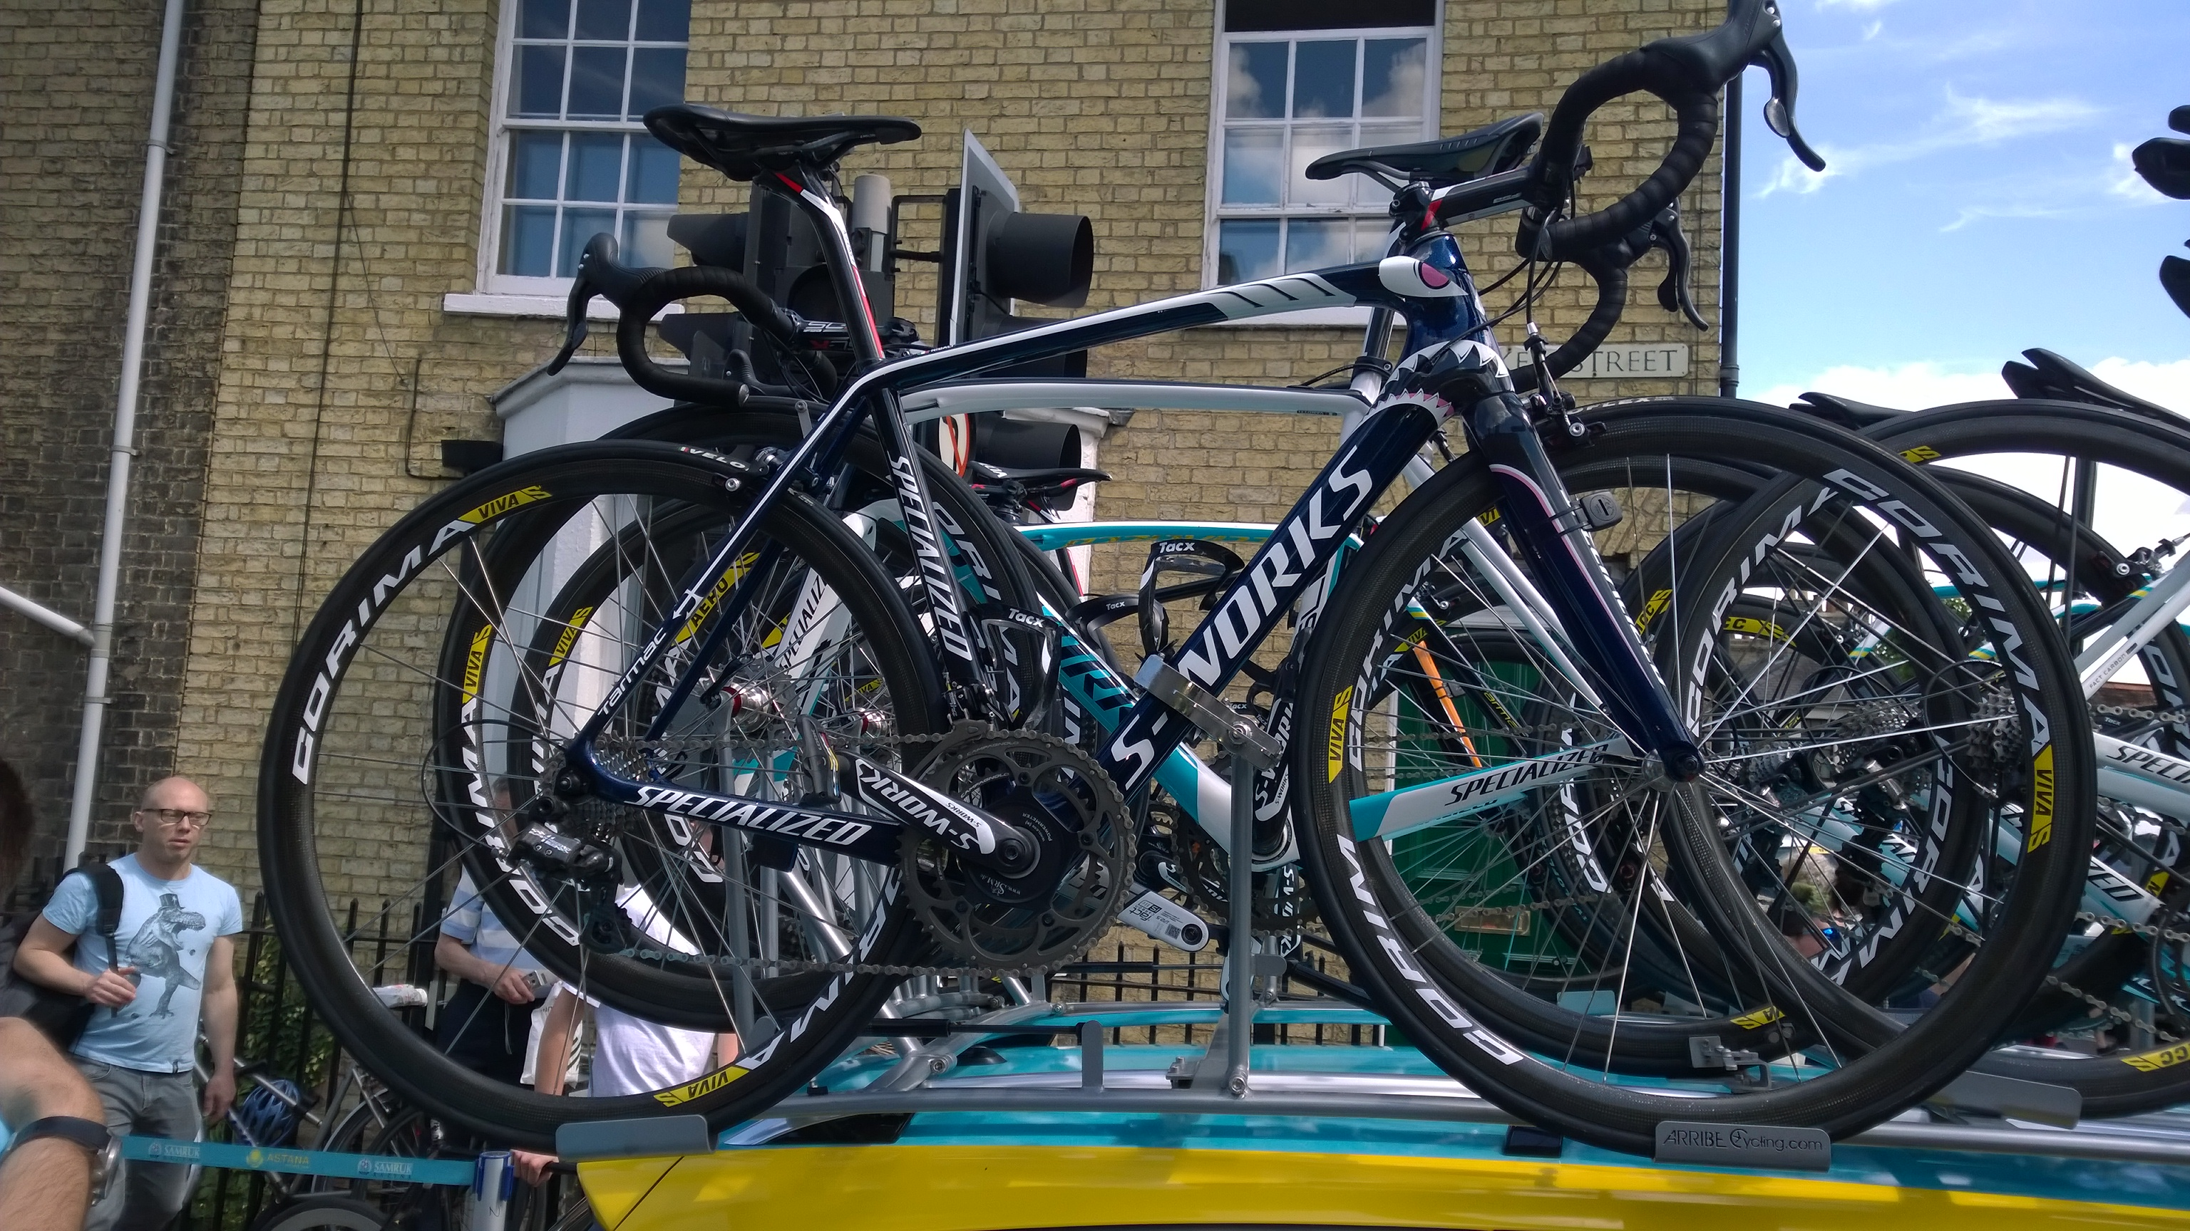

Slide 3
Vision: Usable Verification
Goal: Verification part of the software engineers’ everyday activity
Dream: Verification as easy to use as a compiler or as unit testing
Main Challenges
Practical specification languages
Meaningful (to the programmer) specification language
Effective verification tools
Tools should assist the programmer, not the other way around
Minimal changes to the build environment, be automatic, Scale up, …
Scale: tenths of thousands of classes, hundreds of projects …

Slide 4
1. Writing Specifications

Slide 5
Specifications
Programmers already write specifications
Parameter validations, DataContracts and all kind of attributes in .net code
Want to write more expressive specifications, e.g., Contracts
Contracts = Preconditions, Postconditions, Object invariants
Usual solution: Change the language
Pro: Contracts first class citizens in the language
Nice syntax, keywords …
Con: Require new language (Eiffel) or compiler (Spec#, JML)
Unlikely to happen in industrial setting
Pragmatic solution: Extend language via a library
Use code to specify code

Slide 6
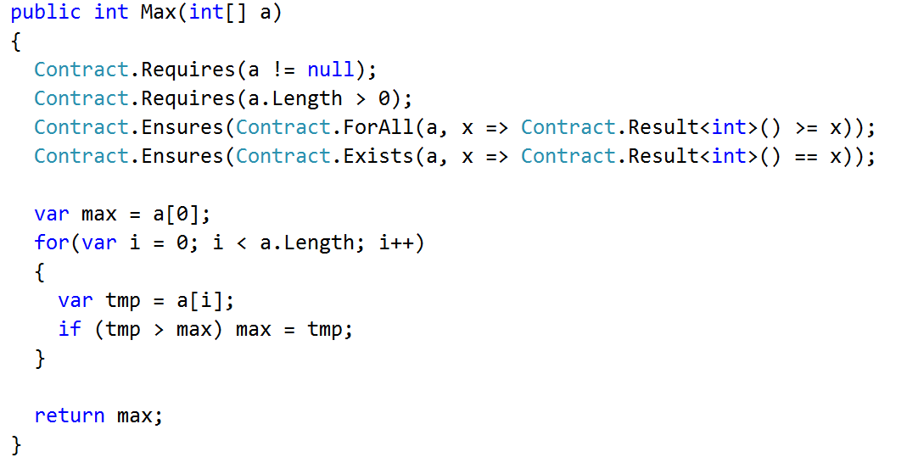
Specifications with CodeContracts
API defined in mscolib
Preconditions
Postconditions (with quantifiers)
Name the result

Slide 7
FAQs
Q: What’s the difference with Debug.Assert?
A: Asserts are not visible, cannot be inherited, no asserts for interfaces/abstract methods
Q: Why not use attributes?
A: Not expressive enough
E.g., In Java, need 15+ attributes only for NonNull specifications!
Q: Why not use comments?
A: Should redo all the work of the compiler

Slide 8
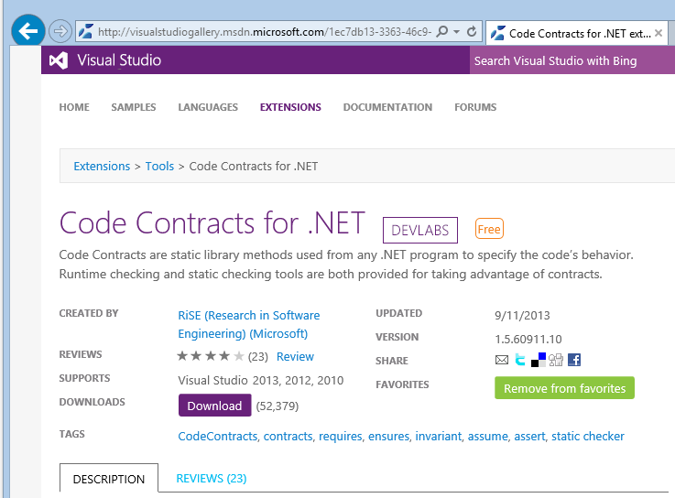
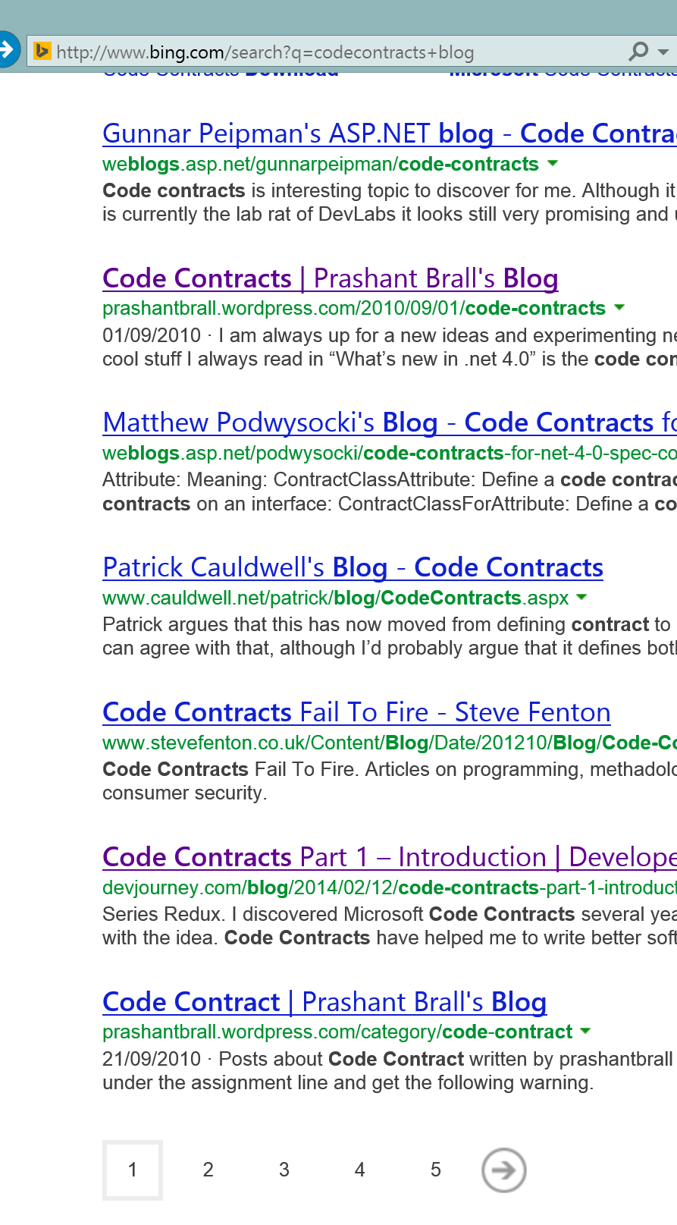
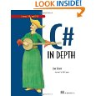

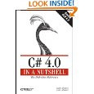
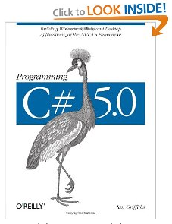
CodeContracts
Internal & external adoption
> 120K downloads, blogs, book chapters …
Pros: Very pragmatic
No need for new language/compiler
Specification are method calls
Clear and defined semantics
Given by the compiler
Leverage IDE/Support
Intellisense, type checking etc.
Cons: Lost beauty
More verbose

Slide 9
Contract Checking
Runtime checking
Via binary rewriting
Insert postconditions at exit points, inherit contracts …
Custom behavior on contract failure
Static checking
Via abstract interpretation
The rest of this talk…

Slide 10
2. Proving specifications

Slide 11

High level view of Clousot
Assertion violations
add
contracts
infer
invariants
check
⇒
generate
report
Dead Code
Code repairs
Contract inference
Use more refined
abstract domain
semantic
hash
save
into cache
M. Fahndrich, F. Logozzo, Static contract checking with Abstract Interpretation, FoVeOOS 2010

Slide 12
FAQ: Why Abstract interpretation?
Infer the loop invariant
a ≠ null ∧ 0 < a.Length ∧ 0 ≤ i ≤ a.Length ∧ ∀ j. 0 ≤ j < i. a[i] ≤ max ∧ ∃ j. 0 ≤ j < i. a[j] = max

Slide 13
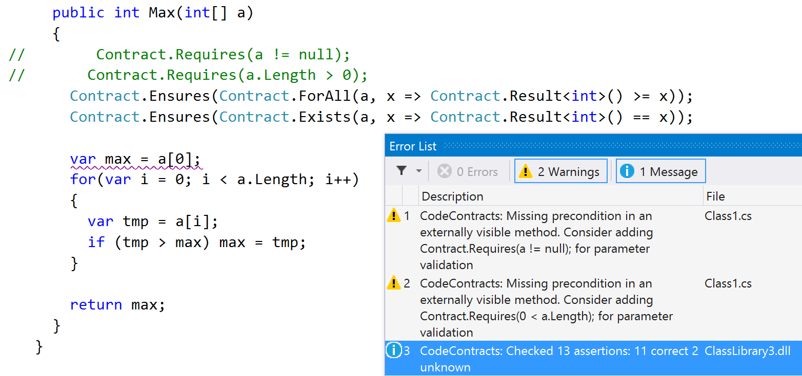
Infer precondition

Slide 14
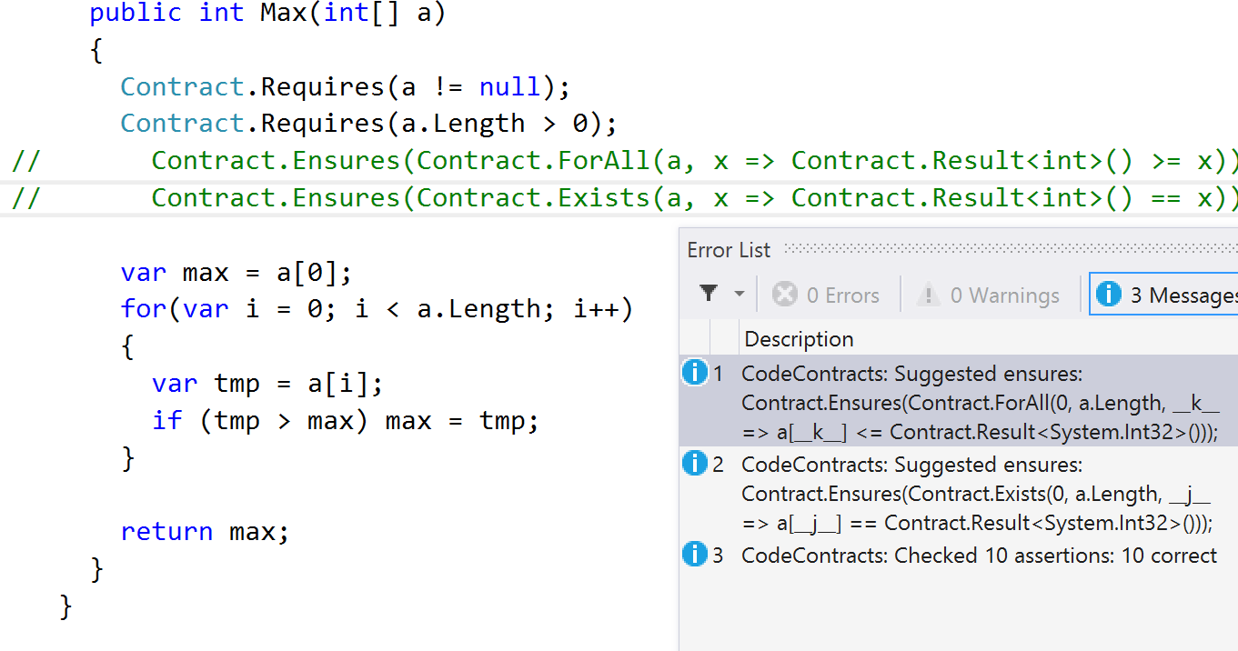
Infer postcondition

Slide 15
Abstract domains in Clousot
Basic domains
IL decompilation, Expression recovery, Optimistic heap analysis, Nullness
Advanced domains
Numerical
Dis-Intervals, Pentagons, Subpolyhedra, Floating points …
Collections
Functor for arrays, ∀/∃-Quantifiers, array modifications …
Others
Disjunctions, Enums, strings …
P. Cousot, R. Cousot, F. Logozzo, A Parametric Segmentation Functor for Fully Automatic and Scalable Array Content Analysis, POPL’11
V. Laviron F. Logozzo, SubPolyhedra: A (more) scalable approach to infer linear inequalities, VMCAI’11
P. Ferrara, F. Logozzo, M. Fähndrich, Safer unsafe code for .NET, OOPSLA’08
….

Slide 16
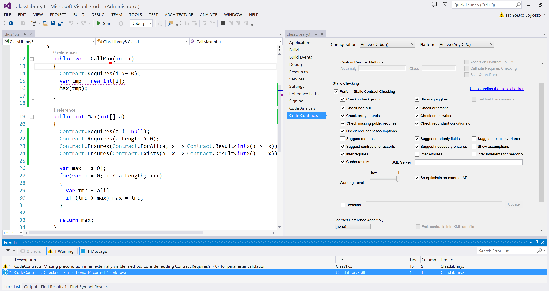
Enable from VS
Prove assertions
Report too weak pre

Slide 17
4. Verified Code Repairs

Slide 18
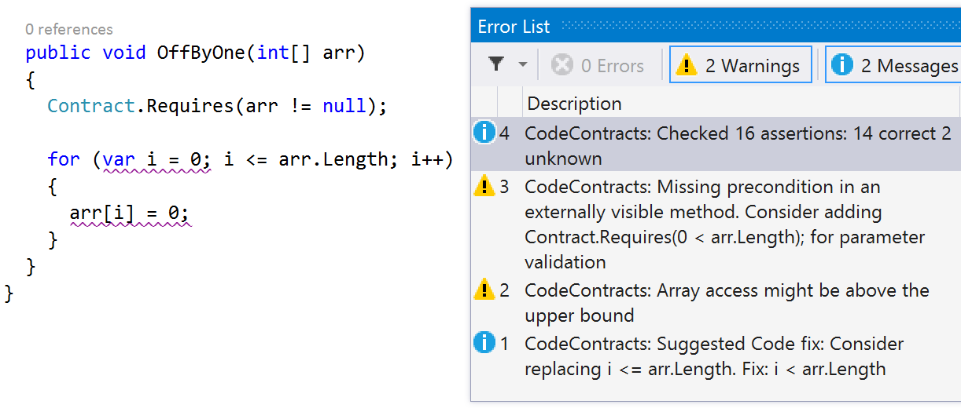
Code Repairs
Alarm
Suggest fix

Slide 19
Program analysis and Code repairs
There are three components in program analysis
The program text
The specification, the property to be specified
The analysis result, the semantic knowledge about the program execution
The (usual) verification problem is
“Check that the analysis result guarantees that the program meets its specification"
The (new) verified code repair problem is
“Refine the program using the analysis result so that it meets its specification”
Related, but different than program synthesis
F. Logozzo and T. Ball, Modular and Verified Automatic Program Repair, OOPSLA'12
F. Logozzo and M. Martel, Automatic Repair of Overflowing Expressions with Abstract Interpretation, in Festschrift for Dave Schmidt, 2013

Slide 20
What is a code repair?
In testing, use the test suite T as a specification
The buggy program fails at least one test in T
The repaired program succeeds all the tests in T
The repaired program is obtained by some mutation of the buggy program
This definition is unsuited for real-time program verification
It requires running the program
At design time, the program is incomplete, does not compile
Test running can be expensive
The repair is as good as the test suite T
Example: fix assert(e) with if(e) assert(e)

Slide 21
Verified code repairs, Intuition
We propose a semantic notion of repairs
A repair is a program transformation r: Prog → Prog
A verified repair reduces the bad runs B(P), while increasing the good runs G(P)
A good run is one that satisfies the specification
Assertion, precondition, runtime condition …
A bad run is one that violates the specification
Consequences:
When we repair a program we cannot remove any good behavior
There can be multiple, non comparable, repairs
No best repair in general!

Slide 22
Verified code repairs
Idea: compare only the assertion truths values of P and r(P)
Define an abstraction function α in four steps
1. Remove all the states but those containing an assertion
Focus on assertions
2. Remove all assertions in r(P) but not in P
Compare only the “old” assertions
3. Have sets of states instead of sets of traces
Forget the casual relationship between states
4. Have assertion truth value instead of the particular values of the variables
Definition: r is a verified code repair if
α (G(P)) ⊆ α (G(r(P))) and α (B(P)) ⊃ α (B(r(P)))

Slide 23
Repairing floats
⊤
double f;
void SimpleError(double a, double b)
{
var tmp = a + b;
this.f = tmp;
if (this.f == tmp) { … }
}
f32
f64
fext
⊥
Clousot infers
this.f : f64
tmp : fext
Emits warning for precision mismatch
Suggests the verified repair:
tmp = (double)(a + b)

Slide 24
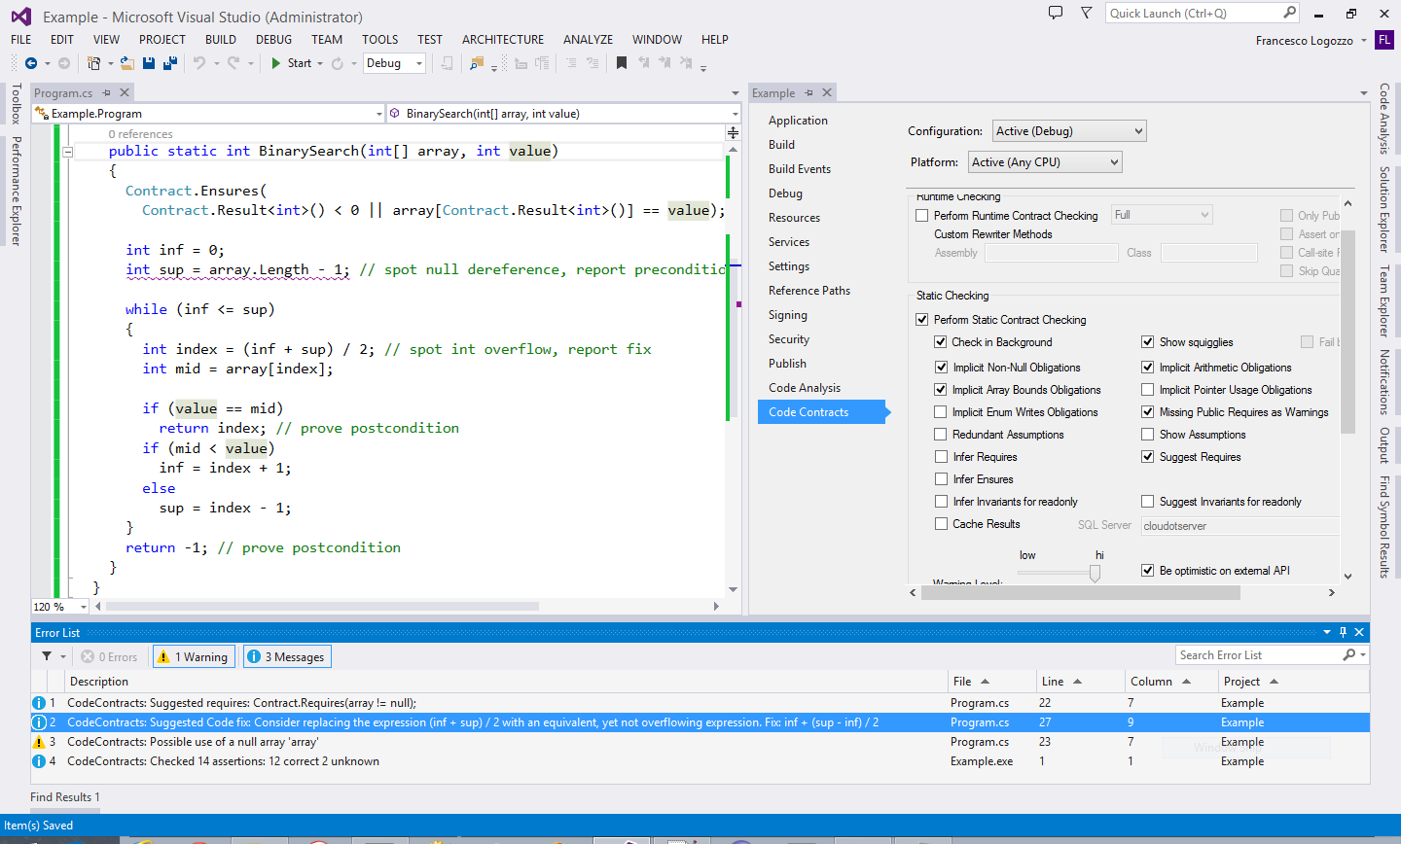
Repairing of overflows
Repairs in Clousot
Constant and object initialization
Guards
Buffer overflows
Arithmetic overflows
Floating point comparisons
…
0 ≤ inf ≤ sup < array.Length ≤ 2³¹-1
Possible overflow
Suggest repair!

Slide 25
3. Contract inference

Slide 26
Inference of contracts
Ideally the software engineer provides all the boundary contracts
As she does with types today
In practice she only provides “few”, the one she thinks are interesting
If the tool cannot infer “evident” contracts then it is labeled as “dumb”
E.g. return new A()
The tool should help the programmer not the other way around
Clousot infers
Necessary preconditions, object invariants, and postconditions
“Easy” postconditions

Slide 27
Necessary and sufficient
In S ⟹ N we say that
S in a sufficient condition for N
N is a necessary condition for S
For a program P
A condition S is sufficient if its truth ensures that P is correct
A condition N is necessary if its falsehood ensures P is incorrect

Slide 28
Inference of preconditions
Define: What is a precondition?
Sufficient precondition: if it holds, the function is correct
Necessary precondition: if it does not hold, the function is definitely wrong
When automatic inference is considered, only necessary preconditions make sense
Sufficient preconditions impose too large a burden to callers
Should be under-approximated in presence of loops
Necessary preconditions are easy to explain to users
Should be over-approximated
They are conditions to errors
P. Cousot, R. Cousot, M. Fahndrich, F. Logozzo, Automatic Inference of Necessary Preconditions, VMCAI’13
M. Bouaziz, F. Logozzo, M. Fahndrich, Inference of Necessary Field Conditions with Abstract Interpretation, APLAS’12

Slide 29
Example
The necessary and sufficient precondition is
x < 0 || a != null
A sufficient precondition
a != null
Too strong for the caller
No runtime error when x < 0 and a == null
E.g.: Example(-2, null);
Clousot users complained about it
“wrong preconditions”
int Example(int x, object[] a)
{
if (x >= 0)
{
return a.Length;
}
return -1;
}
Hard to get a sufficient and necessary with loops

Slide 30
Necessary preconditions
All-Paths precondition analysis
Hoists unmodified assertions to the code entry
Infers: a != null
Conditional-path precondition analysis
Hoist assertions by taking into account tests/loops
Use dual-widening for loops
Infers: a.Length > 0
Quantified precondition analysis
Deal with unbounded data structures
∃ j ∈ [0, a.Length). a[j] == 3
int FirstOccurence(int[] a)
{
int i = 0;
while (a[i] != 3)
i++;
return i;
}

Slide 31
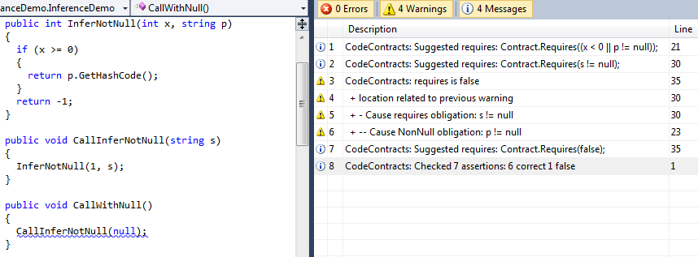
Precondition inference & propagation

Slide 32
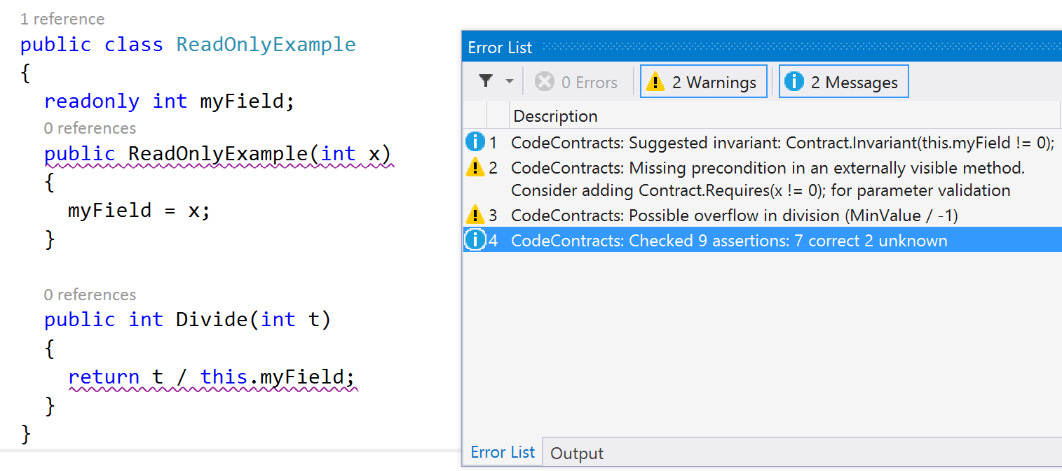
Object invariants inference
Infer object invariant
Infer pre
What about this?

Slide 33
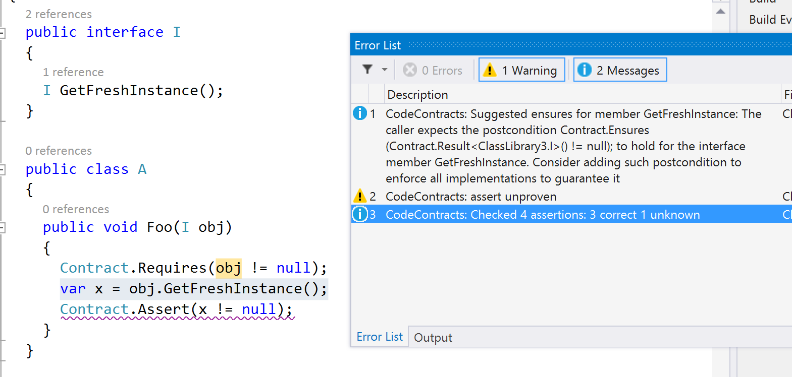
Postconditions inference
Infer post

Slide 34
4. Verification Modulo Versions

Slide 35
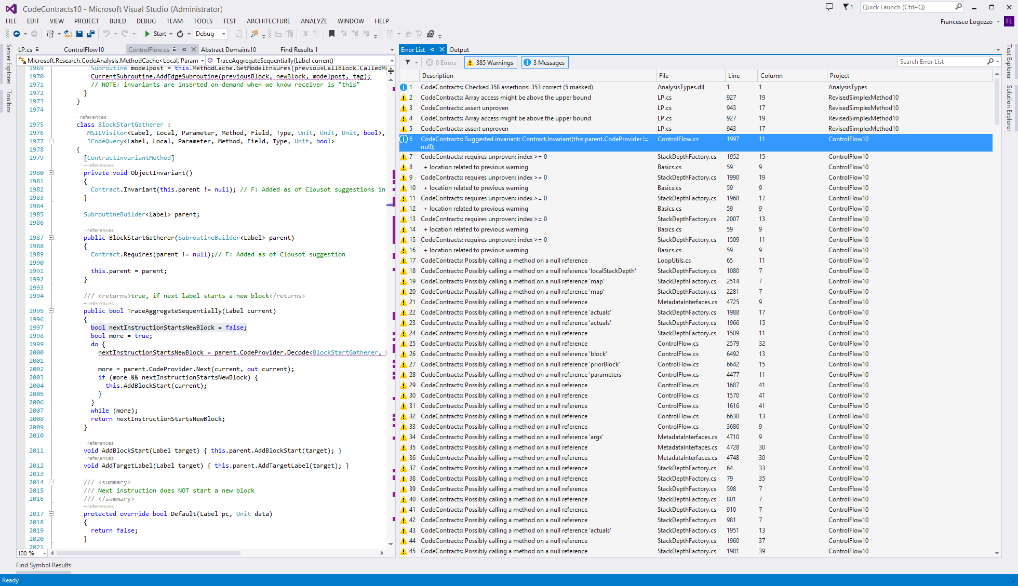
Too many warnings
Notes:
Now, what is the problem? Take your program or library, run cccheck and you get many, many warnings!

Slide 36


Syntactic baseline
Disclaimer:
over-simplified schema
Base version
New version
(k Renamed)
/// Get temperature in Kelvin
double GetCurrTemperature()
{
// In Celsius
1: var c = ReadTemperature();
2: var k = c + 273.15;
3: Contract.Assert(k >= 0);
4: return k;
}
/// Get temperature in Kelvin
double GetCurrTemperature()
{
// In Celsius
1: var c = ReadTemperature();
2: var kelv = c + 273.15;
3: Contract.Assert(kelv >= 0);
4: return kelv;
}
“mask assertion at line 3”
Valid, but can’t prove assertion
Masked:
No alarm

Slide 37
Syntactic baseline: Fail to spot regression
Base version
New version
(wrong constant)
/// Get temperature in Kelvin
double GetCurrTemperature()
{
// In Celsius
1: var c = ReadTemperature();
2: var k = c + 273.15;
3: Contract.Assert(k >= 0);
4: return k;
}
/// Get temperature in Kelvin
double GetCurrTemperature()
{
// In Celsius
1: var c = ReadTemperature();
2: var k = c + 273.0;
3: Contract.Assert(k >= 0);
4: return k;
}
“mask assertion at line 3”
Masked regression!

Slide 38
Syntactic baseline: Resurrect alarm
Base version
New version
(value rounded)
/// Get temperature in Kelvin
double GetCurrTemperature()
{
// In Celsius
1: var c = ReadTemperature();
2: var k = c + 273.15;
3: Contract.Assert(k >= 0);
4: return k;
}
/// Get temperature in Kelvin
double GetCurrTemperature()
{
// In Celsius
1: var c = ReadTemperature();
2: var k = c + 273.15;
3: var round = Math.Round(k, 2);
4: Contract.Assert(round >= 0);
5: return round;
}
“mask assertion at line 3”
Alarm Resurrected

Slide 39
Straw man?
Of course, we can refine the former syntactic baseline technique
Add the assertion name, have a window instead of line number…
However, they are always brittle, and provide no guarantee
Suppress too little
Is the alarm resurrected from the old one?
Suppress too much
Is the masked alarm a new alarm?

Slide 40
VMV: Verification modulo versions
P
Base version
P’
New version
Instrument
P’+C
Instrumented
Analyze
Analyzer is a black box
Reduce alarms up to 70%
With semantic guarantees!!!
Analyze
Extract semantic conditions C
F. Logozzo, S. Lahiri, M. Fahndrich, S. Blackshear, Verification Modulo Versions: Towards Usable Verification, PLDI’14

Slide 41
VMV(S): Finding regressions
Base version
Instrumented
new version
/// Get temperature in Kelvin
double GetCurrTemperature()
{
// In Celsius
1: var c = ReadTemperature();
2: var k = c + 273.15;
3: Contract.Assert(k >= 0);
4: return k;
}
/// Get temperature in Kelvin
double GetCurrTemperature()
{
// In Celsius
1: var c = ReadTemperature();
Contract.Assume(c >= -273.15);
2: var k = c + 273.0;
3: Contract.Assert(k >= 0);
4: return k;
}
Result(ReadTemperature) ≥ -273.15
Correct
⇔
c ≥ -273.15
Report regression!

Slide 42
VMV(N): Relative proofs
Base version
Instrumented
new version
/// Get temperature in Kelvin
double GetCurrTemperature()
{
// In Celsius
1: var c = ReadTemperature();
2: var k = c + 273.15;
3: Contract.Assert(k >= 0);
4: return k;
}
/// Get temperature in Kelvin
double GetCurrTemperature()
{
// In Celsius
1: var c = ReadTemperature();
Contract.Assume(c >= -273.15);
2: var k = c + 273.15;
3: var round = Math.Round(k, 2);
4: Contract.Assert(round >= 0);
5: return round;
}
Result(ReadTemperature) ≥ -273.15
Correct
⇔
c ≥ -273.15
Relative correctness

Slide 43
VMV in 1 slide
Match method calls
P
Base version
P’
New version
Instrument
P’+C
Instrumented
Analyze
Sufficient
⟹ bug finding
Analyze
Extract semantic conditions C
Necessary
⟹ relative verification
Sufficient or Necessary

Slide 44
5. Refactoring

Slide 45
Refactoring &(modular) proofs
public int Decrement(int x)
{
Contract.Requires(x >= 5);
Contract.Ensures(Contract.Result<int>() >= 0);
x = NewMethod(x);
return x;
}
private static int NewMethod(int x)
{
while (x != 0) x--;
return x;
}
Postcondition: ok
public int Decrement(int x)
{
Contract.Requires(x >= 5);
Contract.Ensures(Contract.Result<int>() >= 0);
while (x != 0) checked(x--);
return x;
}
Refactor
Postcondition
Violation?
No overflow
Possible overflow

Slide 46
Conditions on the “extracted” contract
int Decrement(int x)
{
Contract.Requires(x >= 5);
Contract.Ensures(Contract.Result<int>() >=0);
x = NewMethod(x);
return x;
}
Should be a valid contract
Contract.Requires(x >= 5);
Contract.Ensures(Contract.Result<int>()==100);
The contract should imply safety Contract.Ensures(Contract.Result<int>() == 0);
It should be complete
Contract.Requires(x >= 5);
Contract.Ensures(Contract.Result<int>() <= x);
It should be general
Contract.Requires(x >= 5);
Contract.Ensures(Contract.Result<int>() == 0);
Invalid post
Exposes overflow
Can’t prove caller
int NewMethod(int x)
{
// Which contract here???
while (x != 0) checked(x--);
return x;
}
Not general

Slide 47
Our solution
Valid, Safe, Complete, and General contract
public int Decrement(int x) { Contract.Requires(x >= 5); Contract.Ensures(Contract.Result<int>() >=0); x = NewMethod(x); return x; } | private static int NewMethod(int x) { Contract.Requires(x >= 0); Contract.Ensures(Contract.Result<int>() == 0); while (x != 0) checked(x--); return x; }

Slide 48
Algebraic Hoare Logic
We need to formalize the requirements, and in general Contracts
Hoare Logic is the natural candidate
We define a concrete Hoare logic where predicates are replaced by sets
{ P} S { Q } P ∈ ℘(Σ) and Q ∈ ℘(Σ × Σ)
The deduction rules are as usual
Details in the paper
P. Cousot, R. Cousot, F. Logozzo, M. Barnett,
An Abstract Interpretation Framework for Refactoring with Application to Extract Methods with Contracts, OOPSLA’12

Slide 49
Orders on contracts
Covariant order ⟹
Intuition: a stronger precondition is better for the callee
P, Q ⟹ P’, Q’ iff P ⊆ P’ and Q ⊆ Q’
Contravariant order →
Intuition: a →-stronger contract is more general (better for the caller)
P, Q → P’, Q’ iff P’ ⊆ P and Q ⊆ Q’
Note: formal (and more correct) definition in the paper

Slide 50
Some notation…
S denotes the selected code (to be extracted)
It is the body of the extracted method m
P_{s}, Q_{s} is the projection of the abstract state
before the selection, P_{s}
after the selection, Q_{s}
P_{m}, Q_{m} is the most precise safety contract for a method m
P. Cousot, R. Cousot, F. Logozzo, Contract Precondition Inference from Intermittent Assertions on Collections, VMCAI’11

Slide 51
Extract method with contracts problem
The refactored contract P_{R}, Q_{R} is a solution to the problem if it satisfies
Validity
{ P_{R} } S { Q_{R} }
Safety
P_{R},Q_{R}⟹ P_{m}, Q_{m}
Completeness
P_{R},Q_{R} → P_{S},Q_{S} so that { P_{s} } m(…) { Q_{s} }
Generality
∀ P’_{R},Q’_{R} satisfying validity, safety, and completeness: P_{R},Q_{R} → P’_{R},Q’_{R}
Theorem: The 4 requirements above are mutually independent
Covariant order: ⟹
Contravariant order: →

Slide 52
Solution
Theorem: Define
F[S]〈X, Y〉 = 〈P_{m} ∩ pre~[S]Y, Q_{m} ∩ post[S]X〉
Then there exists a unique solution P_{R},Q_{R} to the extract with contracts problem
P_{R},Q_{R} = P_{m},post[S]P_{m} = gfp_{(Ps, Qs)} F[S]
The order for the greatest fixpoint computation is →
Intuition
Take the strongest necessary condition, and the strongest postconditions from it
Or, Start from the projection and weaken the precondition and strength the postcondition
Problem: Can’t compute it in practice ⇒ Perform abstraction

Slide 53
Abstract Hoare triples
Given abstract domains A approximating ℘(Σ) and B approximating ℘(Σ × Σ)
Define abstract Hoare triples
{ P } S { Q } ⟺ { γ_{A}(P) } S { γ_{B}(Q) }
Idea: replace the concrete set operations with the abstract counterparts
Abstract Hoare triples generalize usual Hoare logic
Example: Fix A, B to be first order logic predicates
Question: Are the usual rules of Hoare logic valid in the general case?

Slide 54
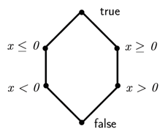
Unsoundness: Disjunction rule
{ x > 0 } x = x*x { x > 0 } { x < 0 } x = x*x { x > 0 }
{ x > 0 ⊔ x < 0 } x = x*x { x > 0 ⊔ x > 0 }
{ true } x = x*x { x > 0 }

Slide 55
We are in trouble?
A similar result holds for the conjunction rule ☹
We need some hypotheses on the abstract domains and the concretizations γ
Theorem: The abstract Hoare triples without the conjunction and disjunction are sound
But we need conjunction to model method call, product of analyses, etc.!
Theorem:
If γ_{A} is finite-join preserving the disjunction rule is sound
If γ_{B} is finite-meet preserving the conjunction rule is sound
For us, conjunction rule is important to model method calls
Luckily, most abstract domains preserve meets!

Slide 56
Inference Algorithm
Use the Roslyn refactoring service to detect the extracted method m
Use Clousot to infer P_{s}, Q_{s}
Project the entry state on the beginning of the selection(P_{s}). Similarly for Q_{s}
Annotate the extracted method with P_{s}, Q_{s}
Use Clousot to infer P_{m}, Q_{m}
Add P_{m}, Q_{m} to the extracted method and start the abstract gfp computation
Use Clousot for the abstract semantics
Weaken the precondition, strengthen the postcondition
Preserve P_{s}, Q_{s}

Slide 57
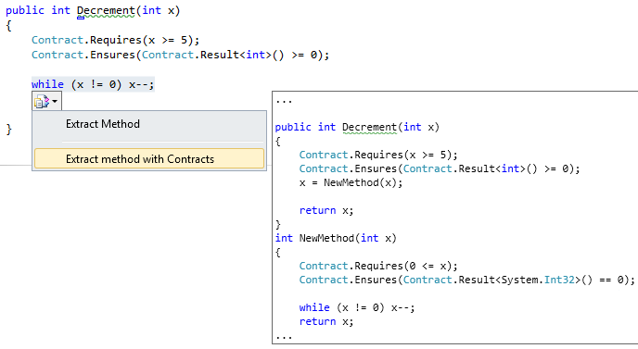
Screenshot

Slide 58
6. Conclusions

Slide 59
Steps towards usable verification
Usable verification
Programmer friendly, precise, scales up, automatic
CodeContracts
Specification with libraries
Part of .NET
Static verification with abstract interpretation
Contract inference
Code repairs
Verification modulo versions
Refactoring with Contracts

Slide 60
Backup slides

Slide 61
Weakest (liberal) preconditions
Provide sufficient preconditions guaranteeing partial correctness:
wlp(P, true)(s₀) ≝ (B(s₀) = ∅)
Drawbacks of wlp for the automatic inference of preconditions:
With loops, no algorithm to compute wlp(P, true)
Solution in deductive verification: Use loop invariant
Inferred preconditions are sufficient but not the weakest anymore
Under-approximation
Sufficient preconditions rule out good runs
Callers should satisfy a too strong condition

Slide 62
Example
int Sum(int[] xs)
{
Contract.Requires(xs != null);
int sum = 0;
for (var i = 0; i < xs.Length; i++)
sum += xs[i];
Contract.Assert(sum >=0);
return sum;
}
Assume overflows not an error
Ex. Sum([-2147483639, 2147483638, -10]) = 19
Which is the weakest precondition?
The method itself
Sufficient preconditions:
∀i ∈ [0, xs.Length], 0 ≤ xs[i] < MaxInt/xs.Length
or
xs.Length == 3 ∧ xs[0] + xs[1] == 0 ∧ xs[2] >= 0
or
….

Slide 63
Strongest necessary preconditions
If the program terminates in a good state for s₀ then N(s₀) should hold:
[I(s₀) = ∅] ⟹ [G(s₀) ≠ ∅ ⟹ N(s₀)]
Equivalently
[I(s₀) = ∅] ⟹ [¬N(s₀) ⟹ (G(s₀) = ∅ ∧ B(s₀) ≠ ∅ )]
i.e., if N does not hold, either
The program diverges, or
The program reaches a bad state
Strongest (liberal) necessary precondition:
snp(P, true)(s₀) ≝ ¬[G(s₀) = ∅ ∧ B(s₀) ≠ ∅]= [G(s₀) ≠ ∅ ∨ B(s₀) = ∅]

Slide 64
Comparison, ignoring non-termination
Weakest sufficient preconditions
Strongest necessary preconditions
 |  | G(s₀)
 | S(s₀) | ∅ | ≠ ∅
B(s₀) | ∅ | true | true
 | ≠ ∅ | false | false
 |  | G(s₀)
 | N(s₀) | ∅ | ≠ ∅
B(s₀) | ∅ | true | true
 | ≠ ∅ | false | true

Slide 65
Approximation of necessary conditions
Static analyses to infer an error condition E such that
E(s₀) ⟹ [G(s₀) = ∅ ∧ B(s₀) ≠ ∅]
i.e., E is sufficient to guarantee the presence of definite errors or non-termination
E is an under-approximation of the error semantics
The negation, ¬E = N is weaker than the strongest (liberal) necessary precondition:
G(s₀) ≠ ∅ ∨ B(s₀) = ∅ ⟹ ¬E(s₀)

Slide 66
Why Abstract Interpretation?
In a nutshell: It’s automatic
Need to infer loop invariants, necessary preconditions, “easy” postconditions
Cannot ask the programmer to provide all of them
Focus on the properties of interests
Non-null checking is still a big problem, cause of most bugs in production software
And no, a non-null type system does not work! E.g., partial array initializations or out params
It is deterministic, predictable, fast, follows the program flow
For programmers: Can “easily” figure out the origin of alarms
For modern building systems: Can rely on it
Enables inference mining
Dead code, verified code repairs, refactoring with contracts, semantic queries …

